Slide 1
Smart Factory Service
IoT Term Assignment
By
Team SFS

Slide 2
Contents
01
Problem statement
02
Solution statement
03
Architecture
04
Who and Why use it
05
Demo
06
Challenges and Counter Measures

Slide 3


01
Problem statement

Slide 4
BUTTERFLY EFFECT

Slide 5
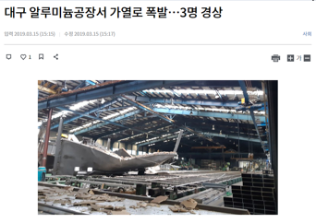
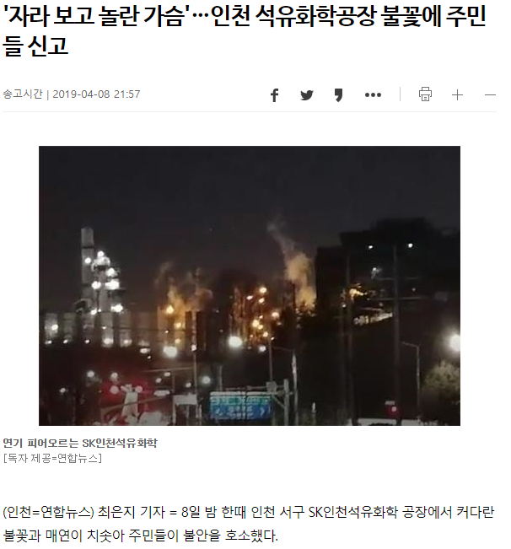
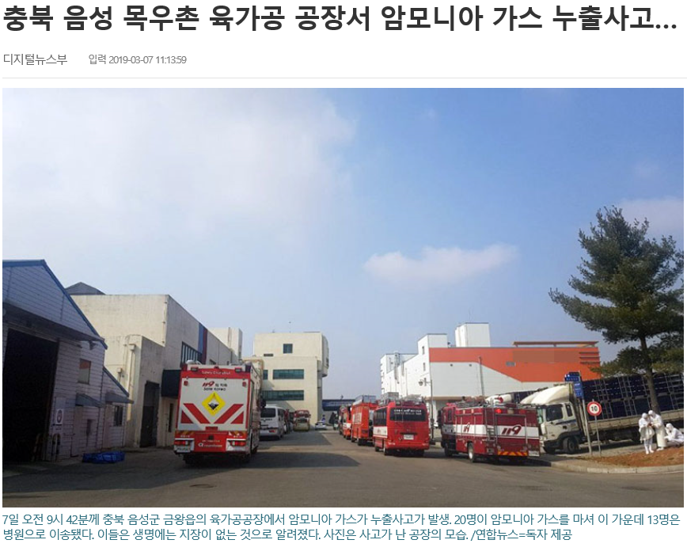
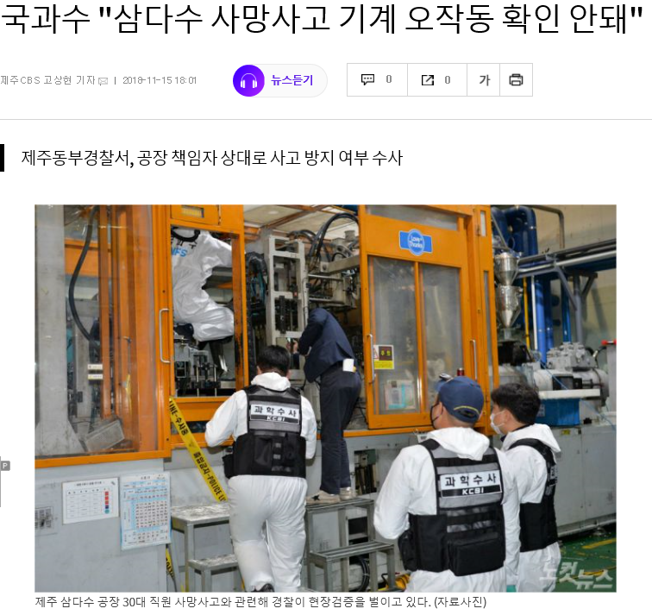

Slide 6
the belly button is bigger than the belly

Slide 7
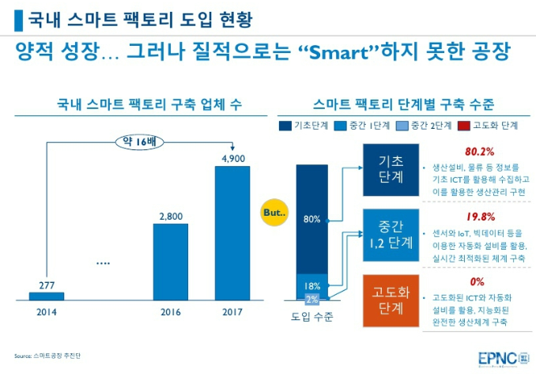
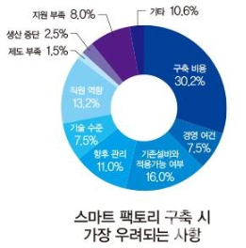

Slide 8

02
Solution statement

Slide 9
BUTTERFLY eFfECT

Slide 10
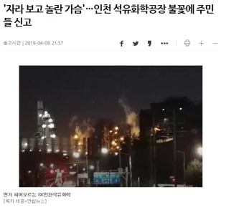
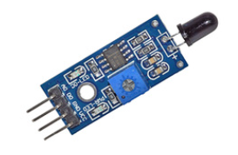

Slide 11
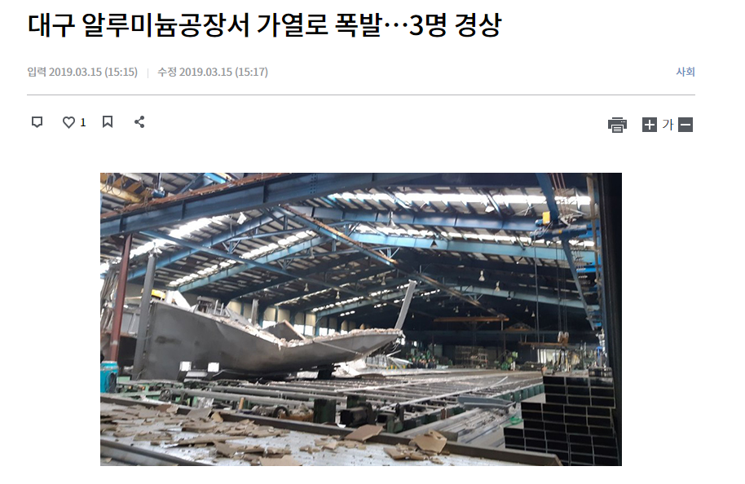
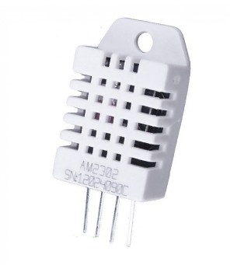

Slide 12
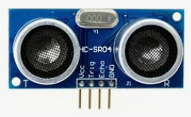
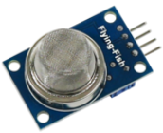

Slide 13
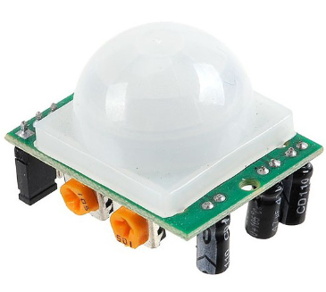

Slide 14
the belly button is bigger than the belly

Slide 15
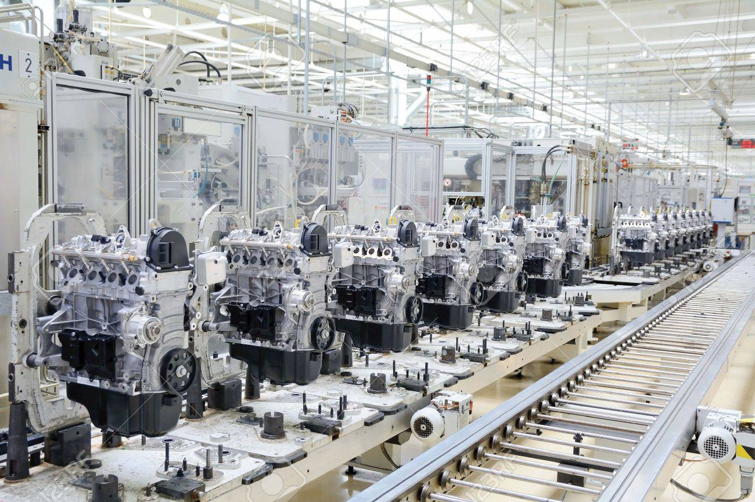

Slide 16

03
Architecture

Slide 17
Power Supply
Machine
FAN
ETC

Slide 18
Power Supply
ESP8266
(KILL Switch)
ESP8266
DHT22
ESP8266
ESP8266
ESP8266
가스센서
Relay Switch
Relay Switch
Relay Switch
화재감지센서
Machine
FAN
ETC
ETC

Slide 19
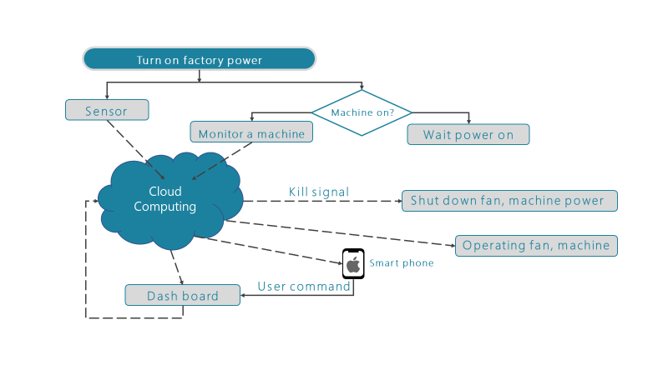

Slide 20
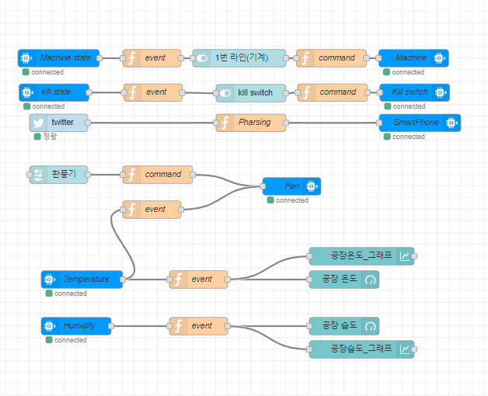

Slide 21


04
Who and Why use it

Slide 22
Who
Small Business Factory
Why
Low-cost
High Effect

Slide 23

05
Demo

Slide 24
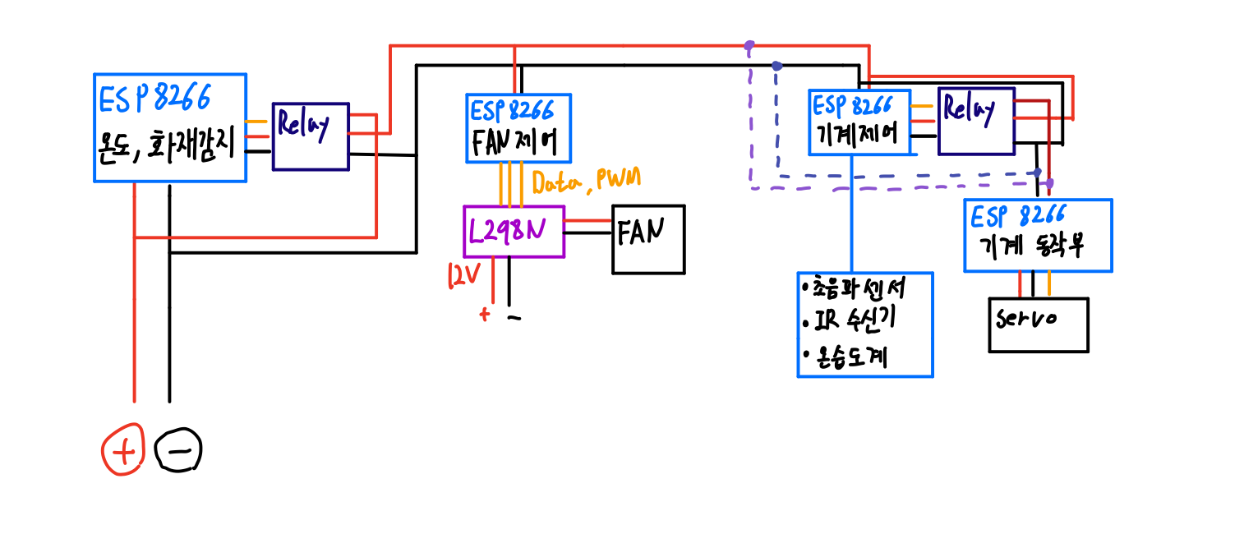
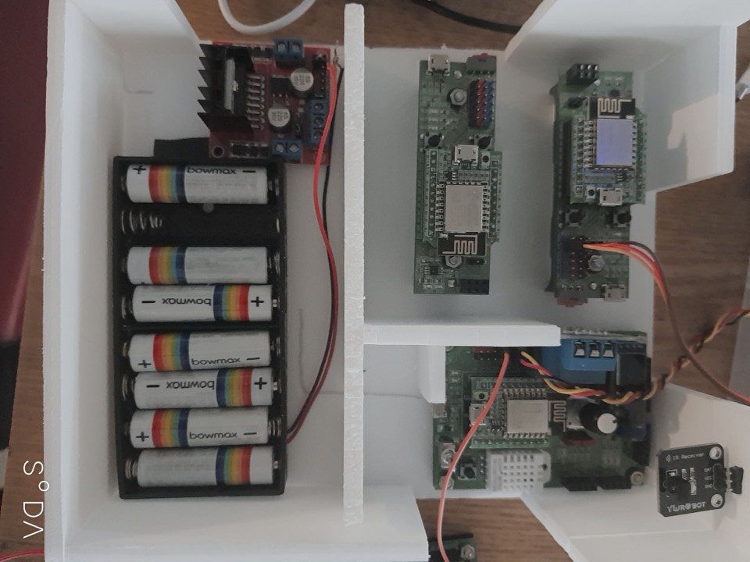

Slide 25

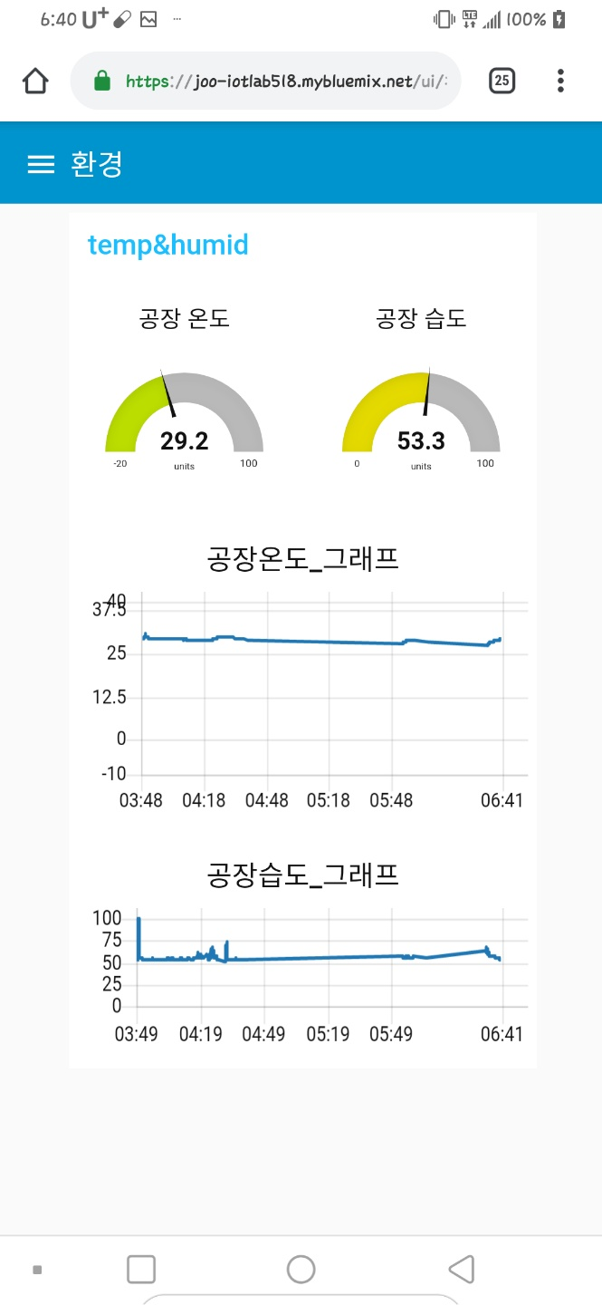
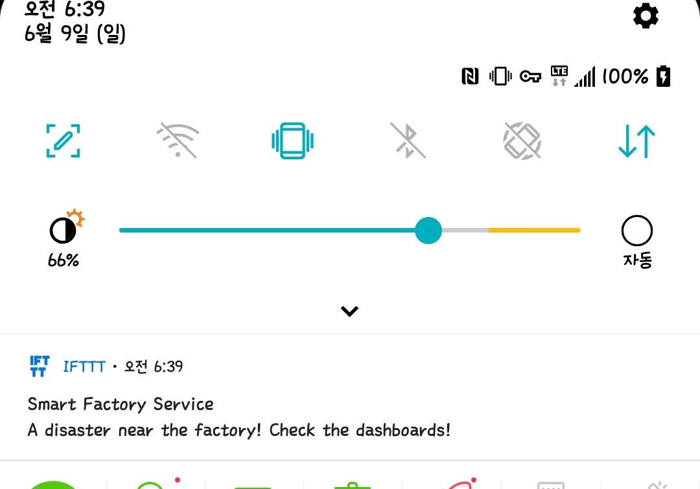

Slide 26
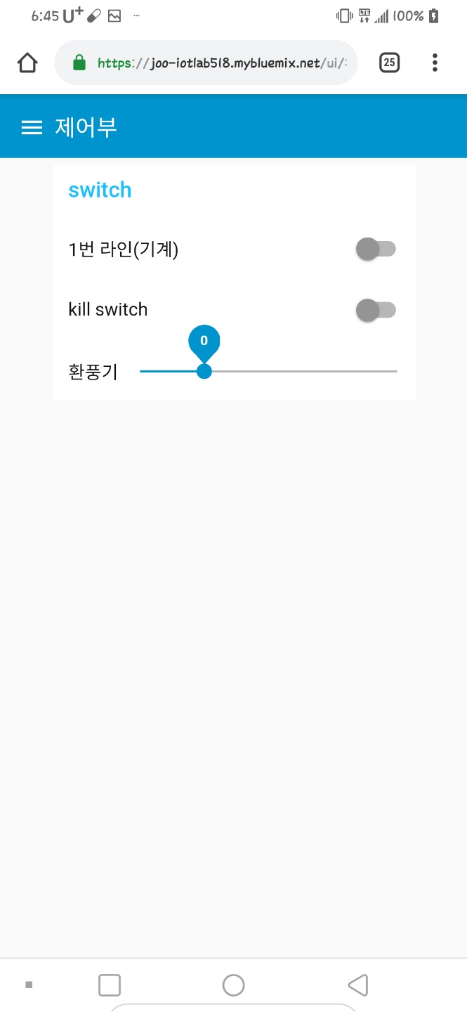

Slide 27
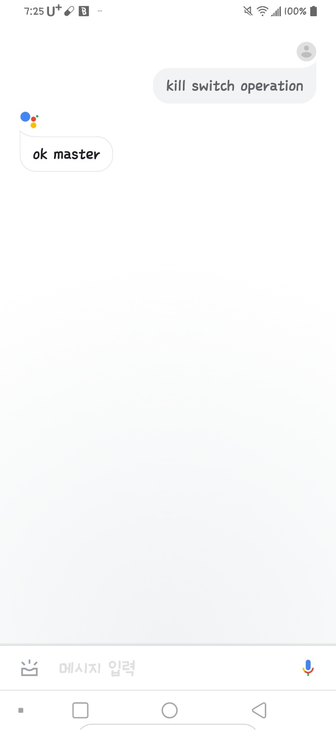

Slide 28


Slide 29
06
Challenges and
Counter Measures

Slide 30
Challenges
견고한 서버와 통신을 필요로 함.
( WiFi로는 한계 )
높은 전력용 Relay 스위치 필요,
기계 이상을 감지하기 쉽지 않음.

Slide 31
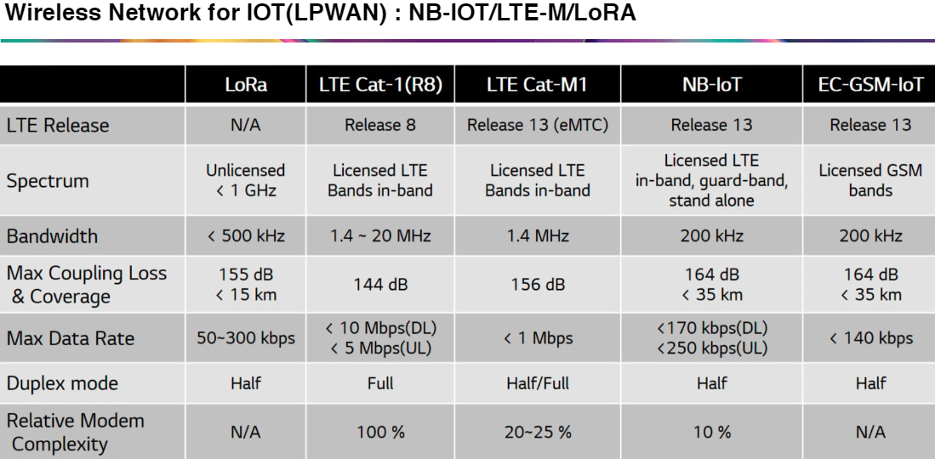
Counter Measures

Slide 32
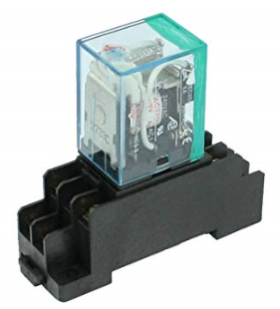
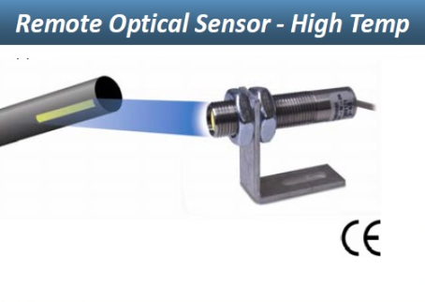
Counter Measures

Slide 33
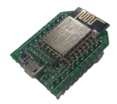


Smart Factory Service
Electronics Everywhere
Network Everything
Cloud Intelligence

Slide 34
Thank You!

